Slide 1
Cell Type Deconvolution by Phosphoproteomics
Bridget Li, Cameron Flower, Angela Ahn, Dr. Forest White

Slide 2
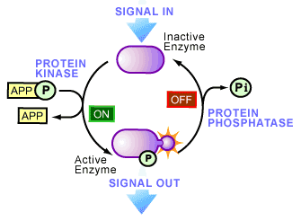
Background
Signal transduction
Protein phosphorylation
Kinases
Phosphatases
Adapter proteins
Cancer
Notes:
Signal transduction- process by which a chemical/physical signal is transmitted through a cell
Protein phosphorylation- reversible modification of proteins in which a phosphate group is added to amino acid residue by protein kinase
Cells use phosphorylation to transfer information within and between themselves, which is necessary to coordinate most phenotypes
Kinases are enzymes that catalyze phosphorylation, and phosphatases remove phosphorylation. Adapter proteins are proteins that bind to phosphorylated proteins to propagate the signal
Many diseases, including cancer, involve a dysregulation of phosphorylation
Different cells, and different cellular states, use phosphorylation differently
Signal transduction pathways play key roles in the initiation and progression of cancer

Slide 3
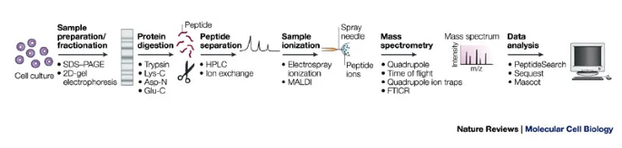
Background
Phosphoproteomics
Mass spectrometry
Notes:
To measure hundreds or thousands of phosphorylation events in cells, we lyse the cells and enrich them for the phosphorylated proteins, which we identify and quantify using a technique called ​mass spectrometry. This whole workflow we call phosphoproteomics
Mass spectrometry (MS)- biomolecules are ionized and their mass is measured by following their specific trajectories in a vacuum system
For MS analysis, the proteins of interest are proteolytically digested — the resulting peptides are easier to handle, easier to sequence and have better detection efficiencies than intact proteins
Trypsin is used to convert proteins to peptides (in preferred mass range for sequencing)
Trypsin- aggressive and stable protease
Thousands of peptides can be introduced to the mass spectrometer through 'on-line' capillary chromatography
Through MS, their masses can be measured and they can be fragmented to yield partial amino-acid-sequence information (tandem MS)
Powerful algorithms can match the data from tandem MS against possible peptide sequences in amino-acid databases

Slide 4
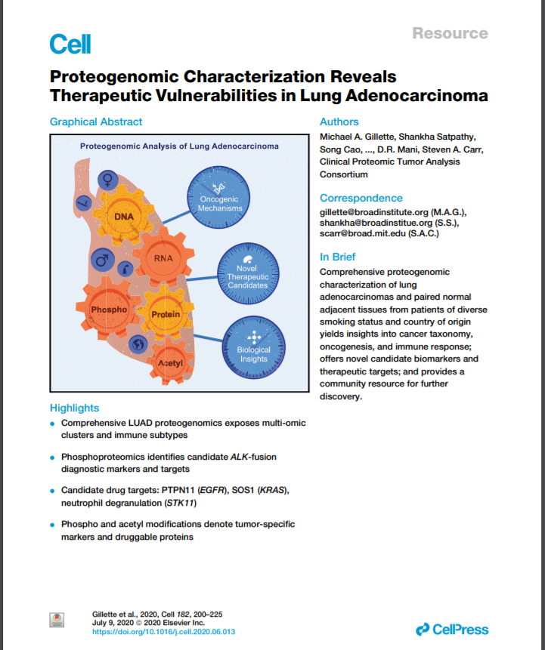
Project Overview
Identify cell types in tumor tissue samples based on bulk phosphoproteomic data
Data from a 2020 study in Cell
Started by doing correlation analysis
Notes:
The overall aim of the project is to develop a computational method that can predict the proportions of distinct cell types based on bulk phosphoproteomic data collected from tumor tissue samples
Currently, there is a challenge with bulk sequencing in tissue analysis. Researchers and doctors want to identify the types of cells found in tumor tissue samples and in what proportions the cells occur. This information could help us understand the biology of complex patient samples and the roles of various cells in tumor growth.
While there are tools that use RNA-seq data to predict cell types in bulk tumor tissue samples, the RNA data does not reflect all of the proteins in the cell. For this reason, we want to develop a computational tool that relies on phosphoproteomic data to more accurately identify cell types in bulk samples. In addition, the phosphoproteomic data could help us determine which proteins are phosphorylated in tumors and which signaling pathways are actively engaged in various cells. This further information may provide insights into cell functions and behaviors.

Slide 5
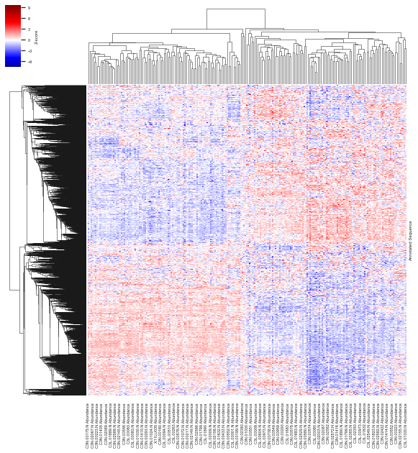
Phosphopeptide vs. Sample Heatmap
5256 peptides
211 samples
Notes:
Separation in samples: tumor vs. normal? Not really
Difference between left and right but don’t know what difference is

Slide 6
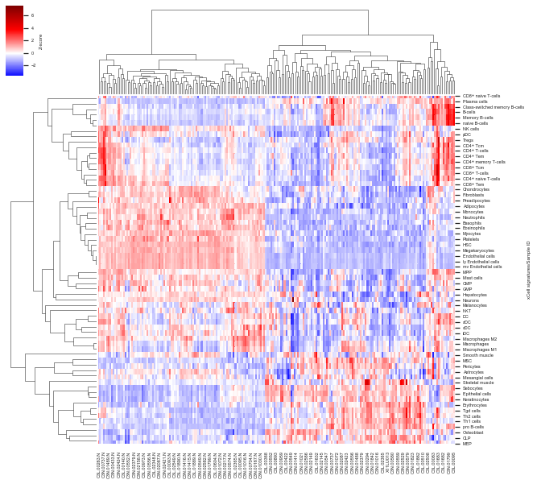
Immune Cell vs. Sample Heatmap
64 immune cells
211 samples
Notes:
Label color bar to show what values represent: z-scores
Separation in tumor vs. normal samples
B-cells at the top (pos for some tumor, neg for normal), CD T-cells below, adaptive immune cells in the middle
Based on rna-seq data

Slide 7
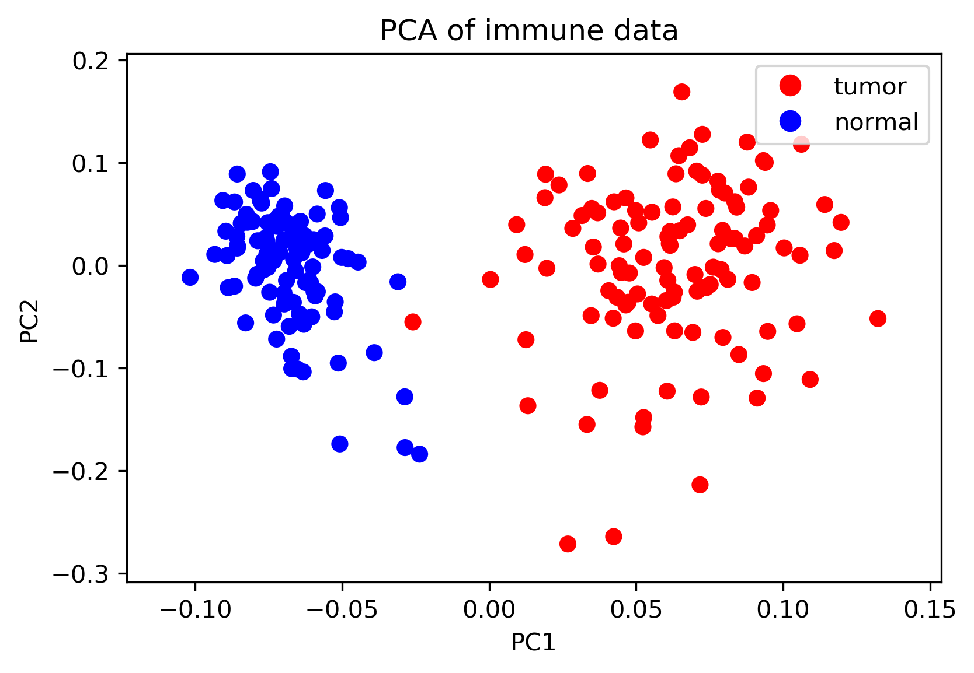
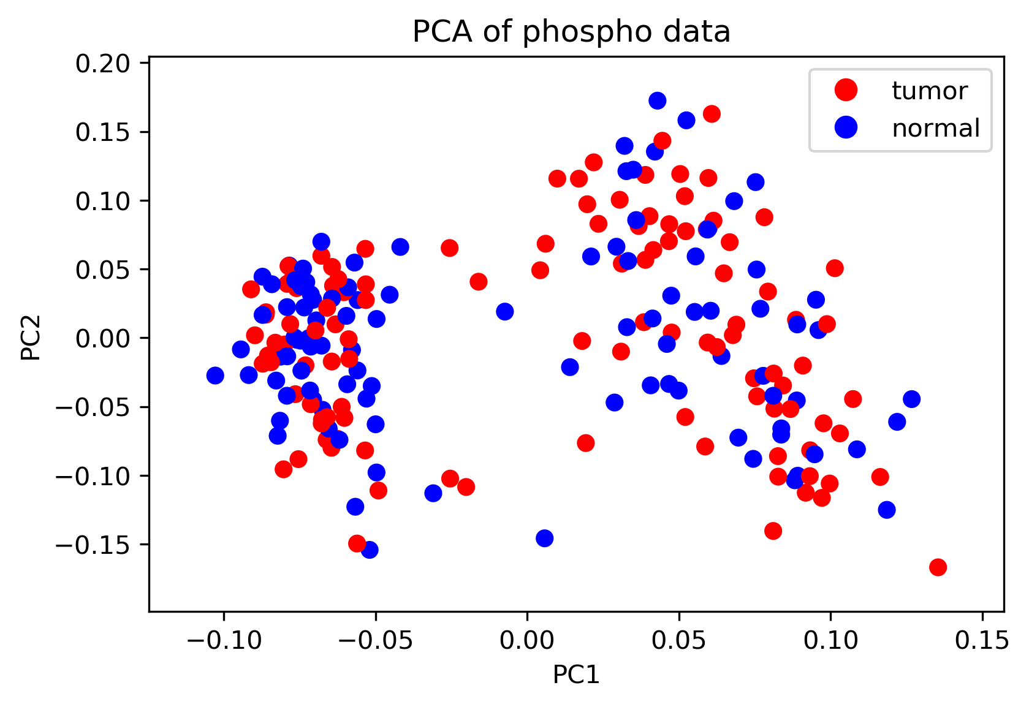
Principal Component Analysis (PCA)
Notes:
PCA- technique used to emphasize variation and bring out strong patterns in a dataset
Representation of data sets
Not much separation in phospho data

Slide 8
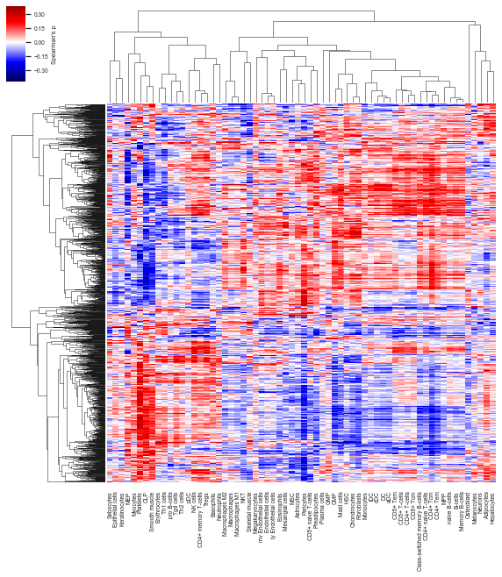
Phosphopeptide vs. Immune Cell Heatmap
1584 peptides
64 immune cells
Notes:
Z-axis: Spearman’s coefficient
Less peptides b/c filtered out peptides with ρ values all between -0.178 and 0.178, corresponding to p<0.01
Describe code and stuff we did: normalization, Python packages
Z-score immune cell and peptide data (normalize for all sample IDs)
Spearman’s: non-linear relationship between peptide and immune cell
Used pandas to work with Excel sheets
Seaborn to create clustermap
Observations: relationship between cells in bottom left and top right, adaptive cell types in the middle (cell types with similar roles cluster together)

Slide 9
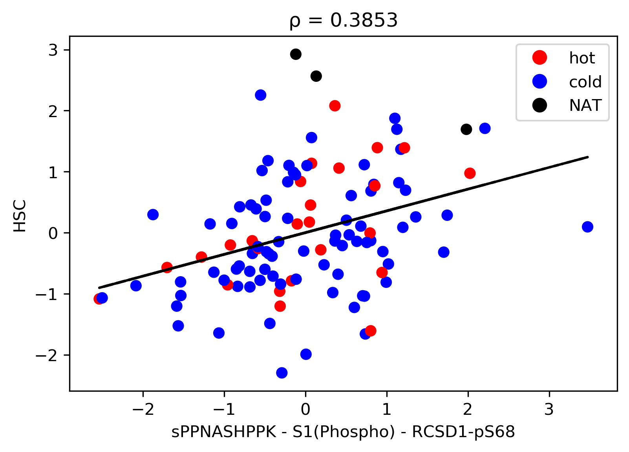
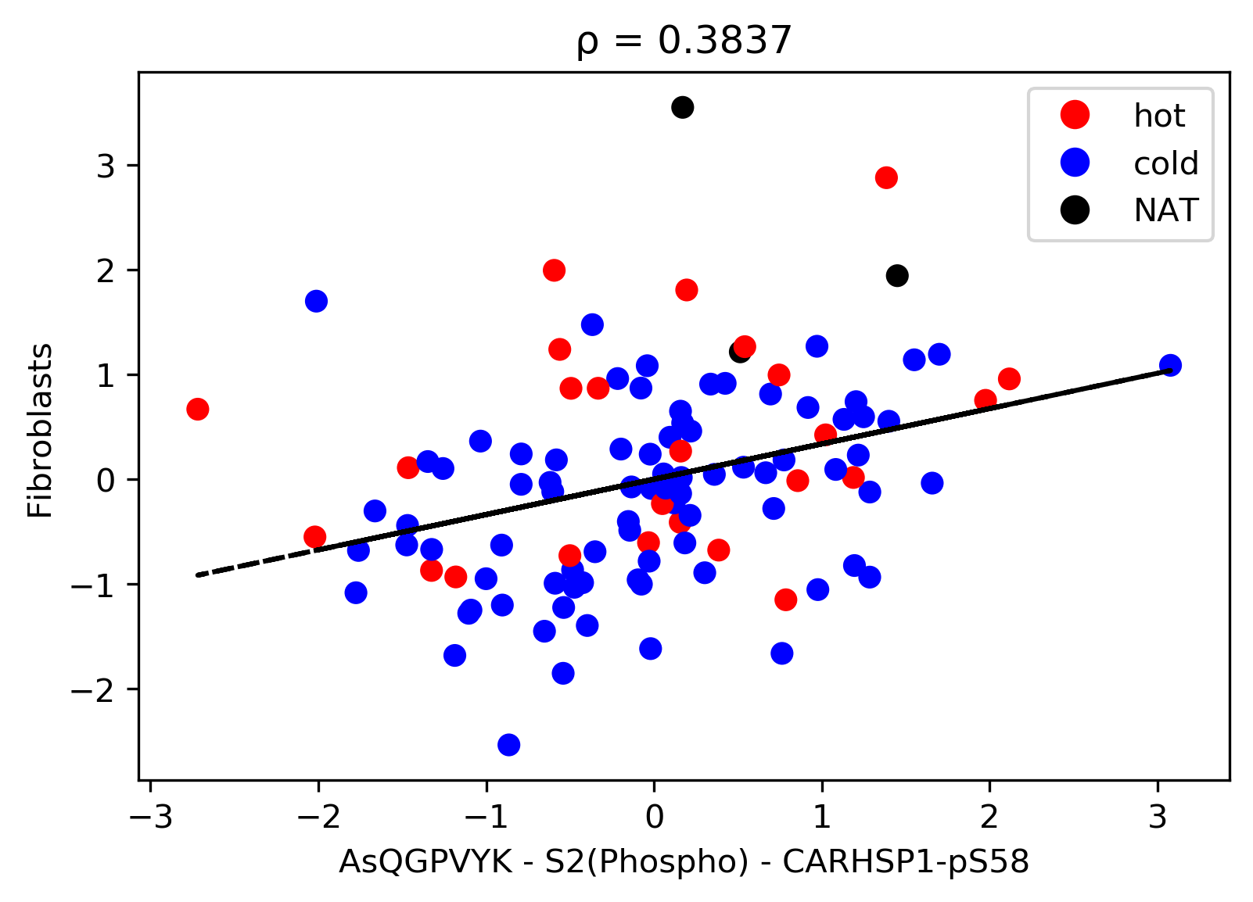
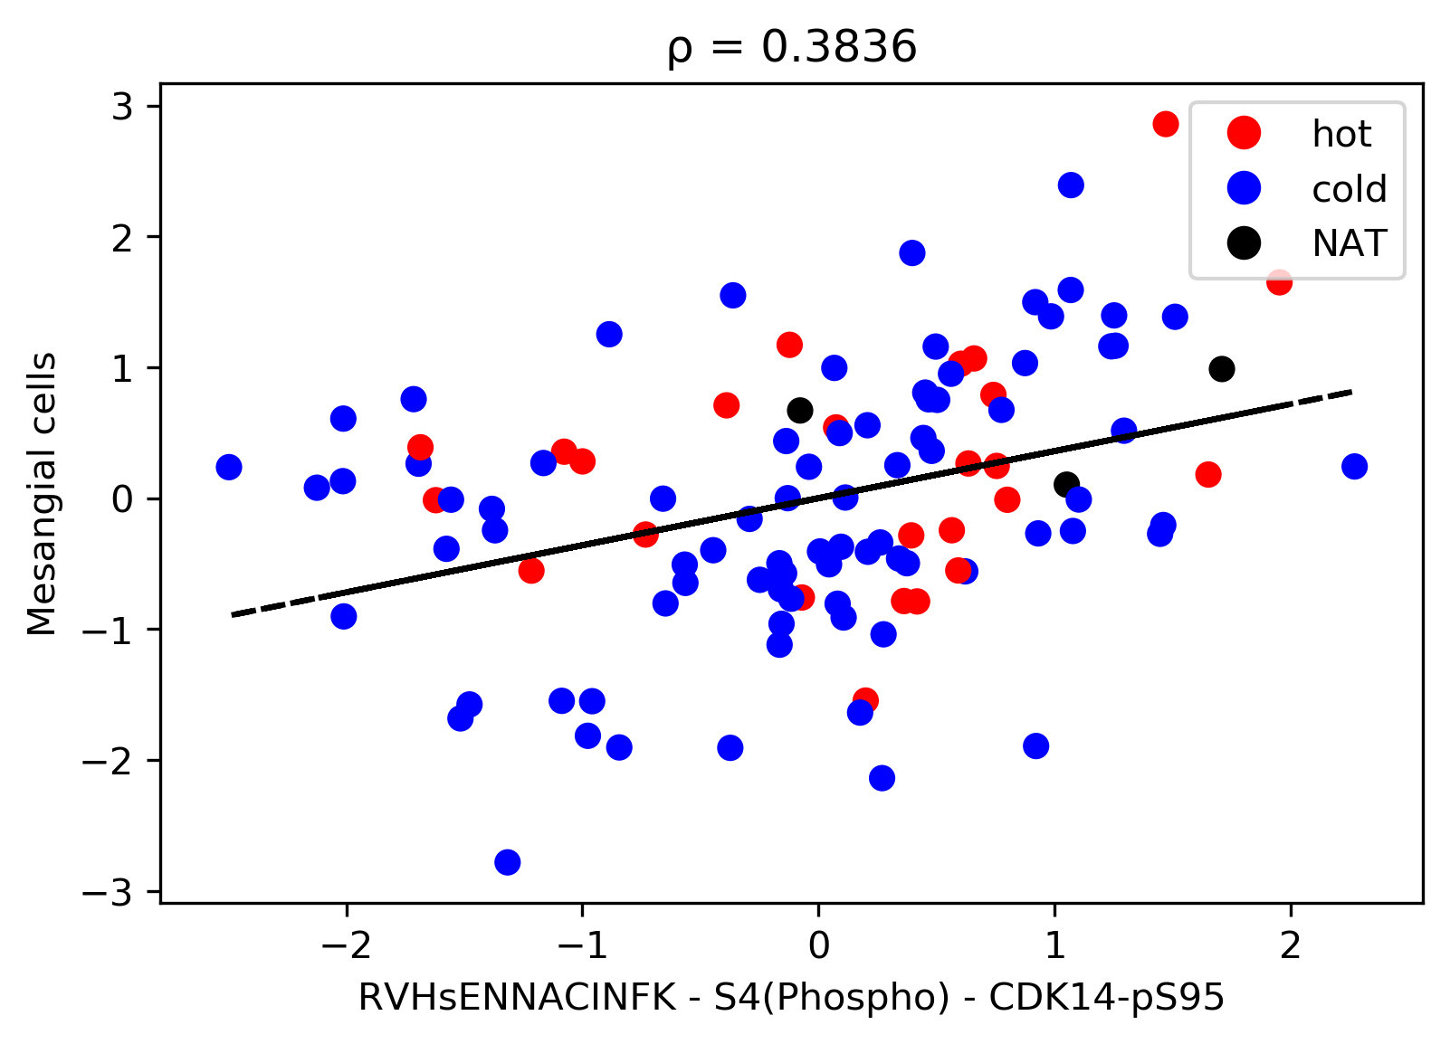
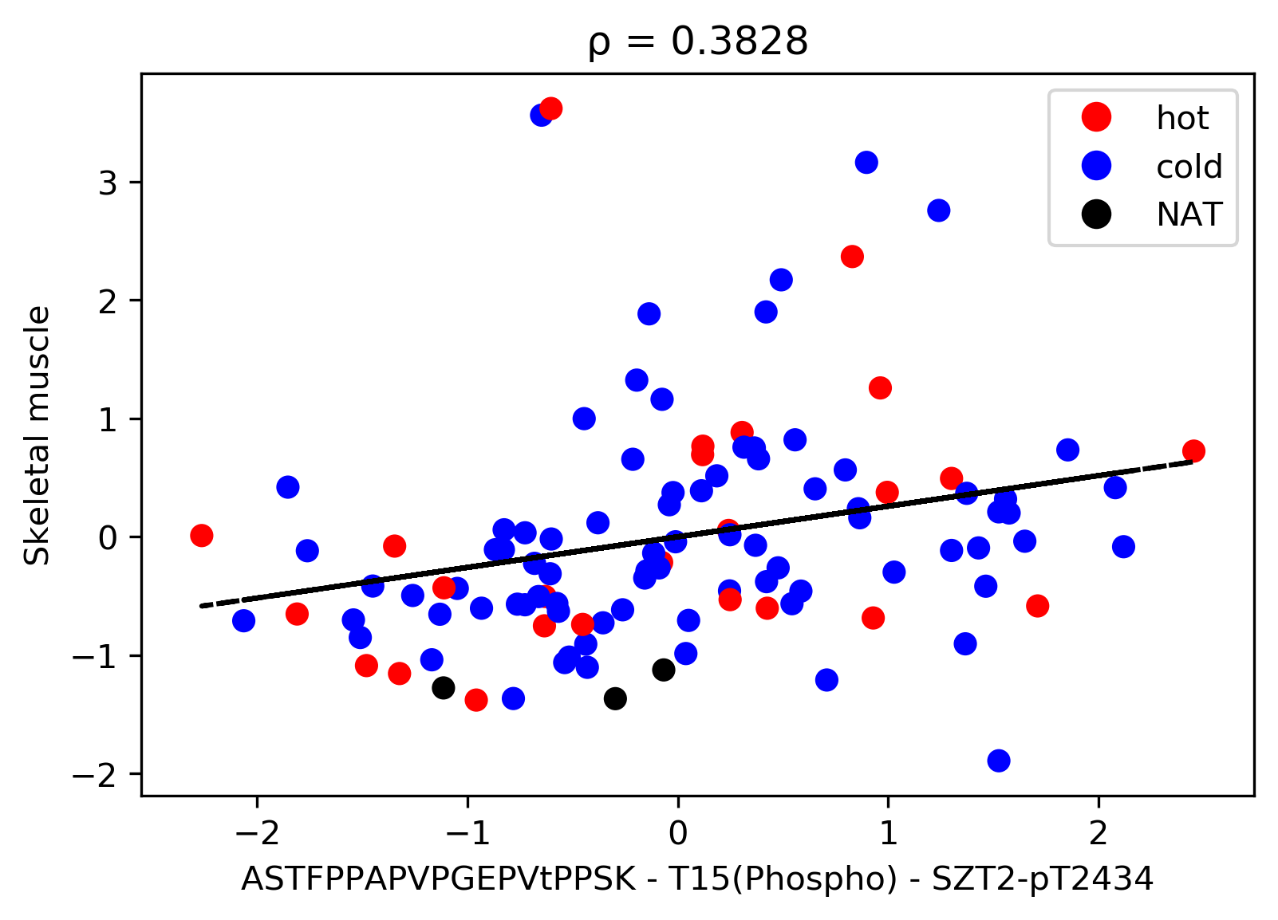
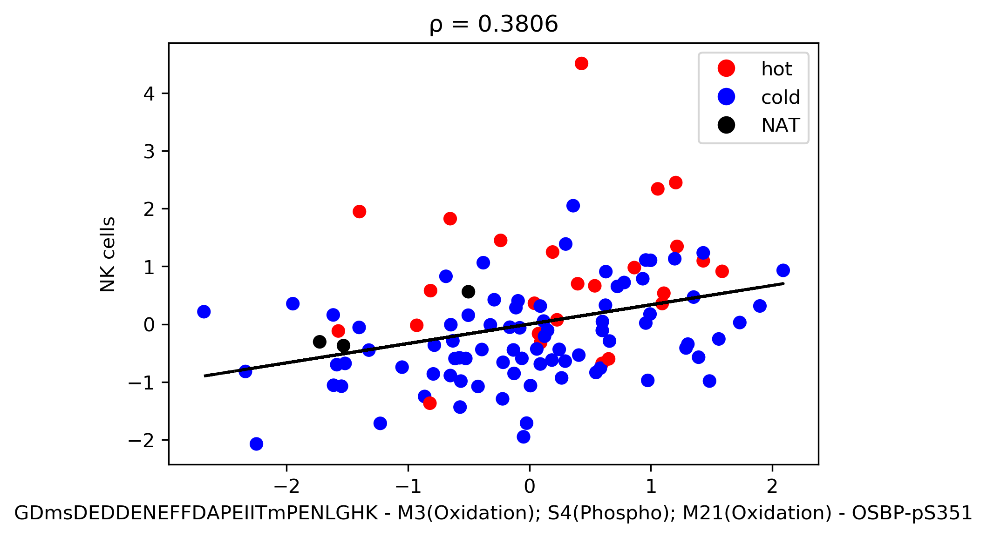
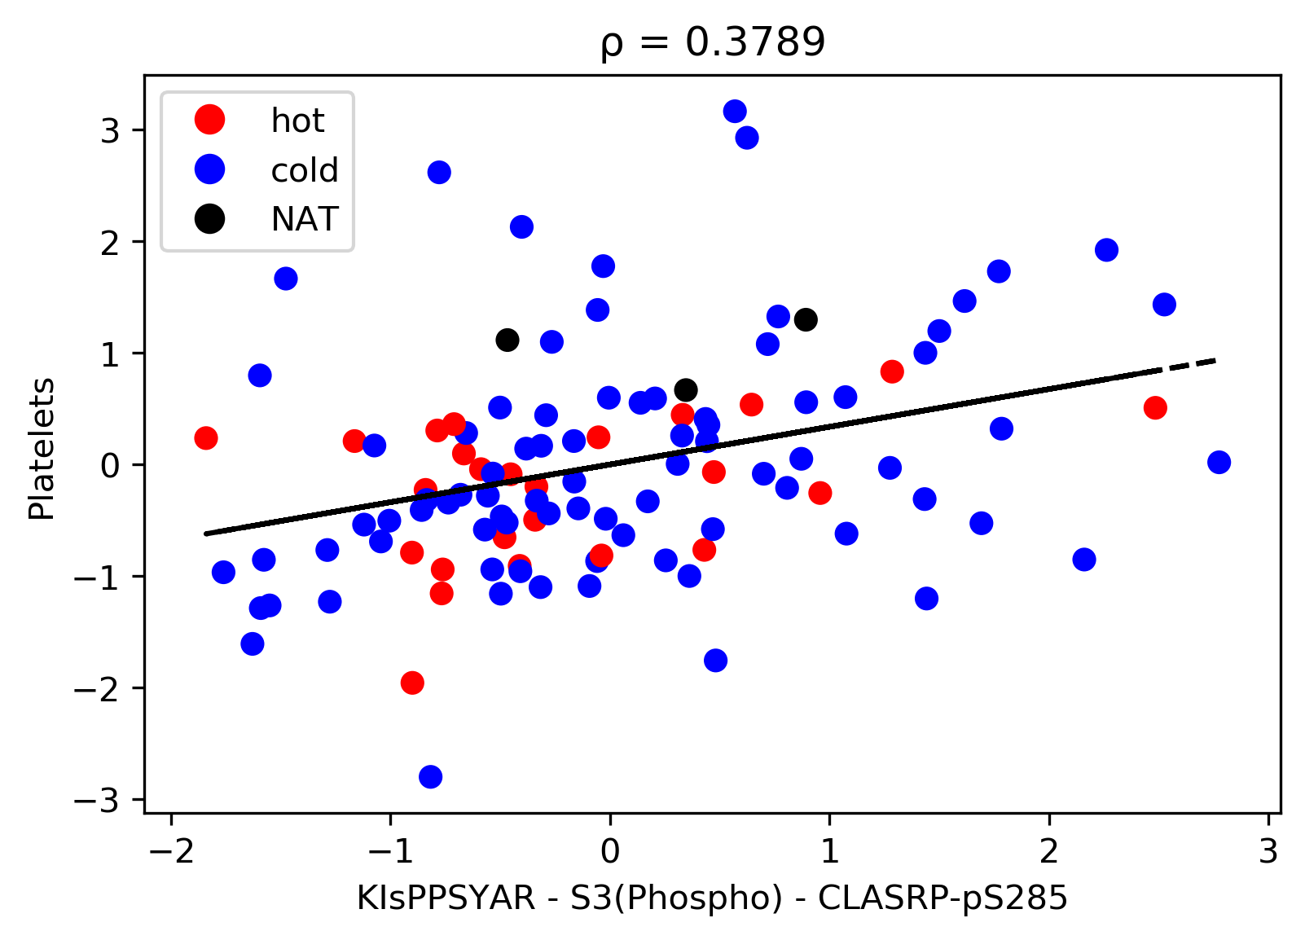
Most Correlated Peptides and Immune Cells
Notes:
Correlations were not that strong
HSC (hematopoietic stem cell)- stem cell; gives rise to all lineages of blood and immune cells (haematopoiesis); occurs in red bone marrow
RCSD1 (CapZip)- cytoskeletal protein; stress-induced phosphorylation may regulate ability of F-actin-capping protein to remodel actin filament assembly
Fibroblast- synthesizes extracellular matrix and collagen; critical in wound healing; most common in connective tissue
CARHSP1 (Calcium-regulated heat-stable protein 1)- binds mRNA and regulates stability of target mRNA
Mesangial cells- kidney cells that make up the mesangium of the glomerulus; secrete an extracellular matrix substance
CDK14 (Cyclin-dependent kinase 14)- serine/threonine-protein kinase involved in the control of the cell cycle; activity is controlled by an associated cyclin
Skeletal muscle- make up muscle tissues connected to skeleton; important in movement
SZT2- part of KICSTOR complex functions in amino acid-sensing branch of TORC1 signaling pathway; recruits GATOR1 complex to lysosomal membranes
NK (natural killer) cells- cytotoxic lymphocyte critical to innate immune system
OSBP (Oxysterol-binding protein 1)- lipid transporter involved in lipid countertransport between Golgi complex and membranes of endoplasmic reticulum
Platelets- small, colorless cell fragments in blood that form clots and stop bleeding; complex activation process leading to integrin activation and formation of a “core” and “shell” at the site of injury
CLASRP (CLK4-associating serine/arginine rich protein)- probably functions as an alternative splicing regulator (mRNA splicing of genes such as CLK1)

Slide 10
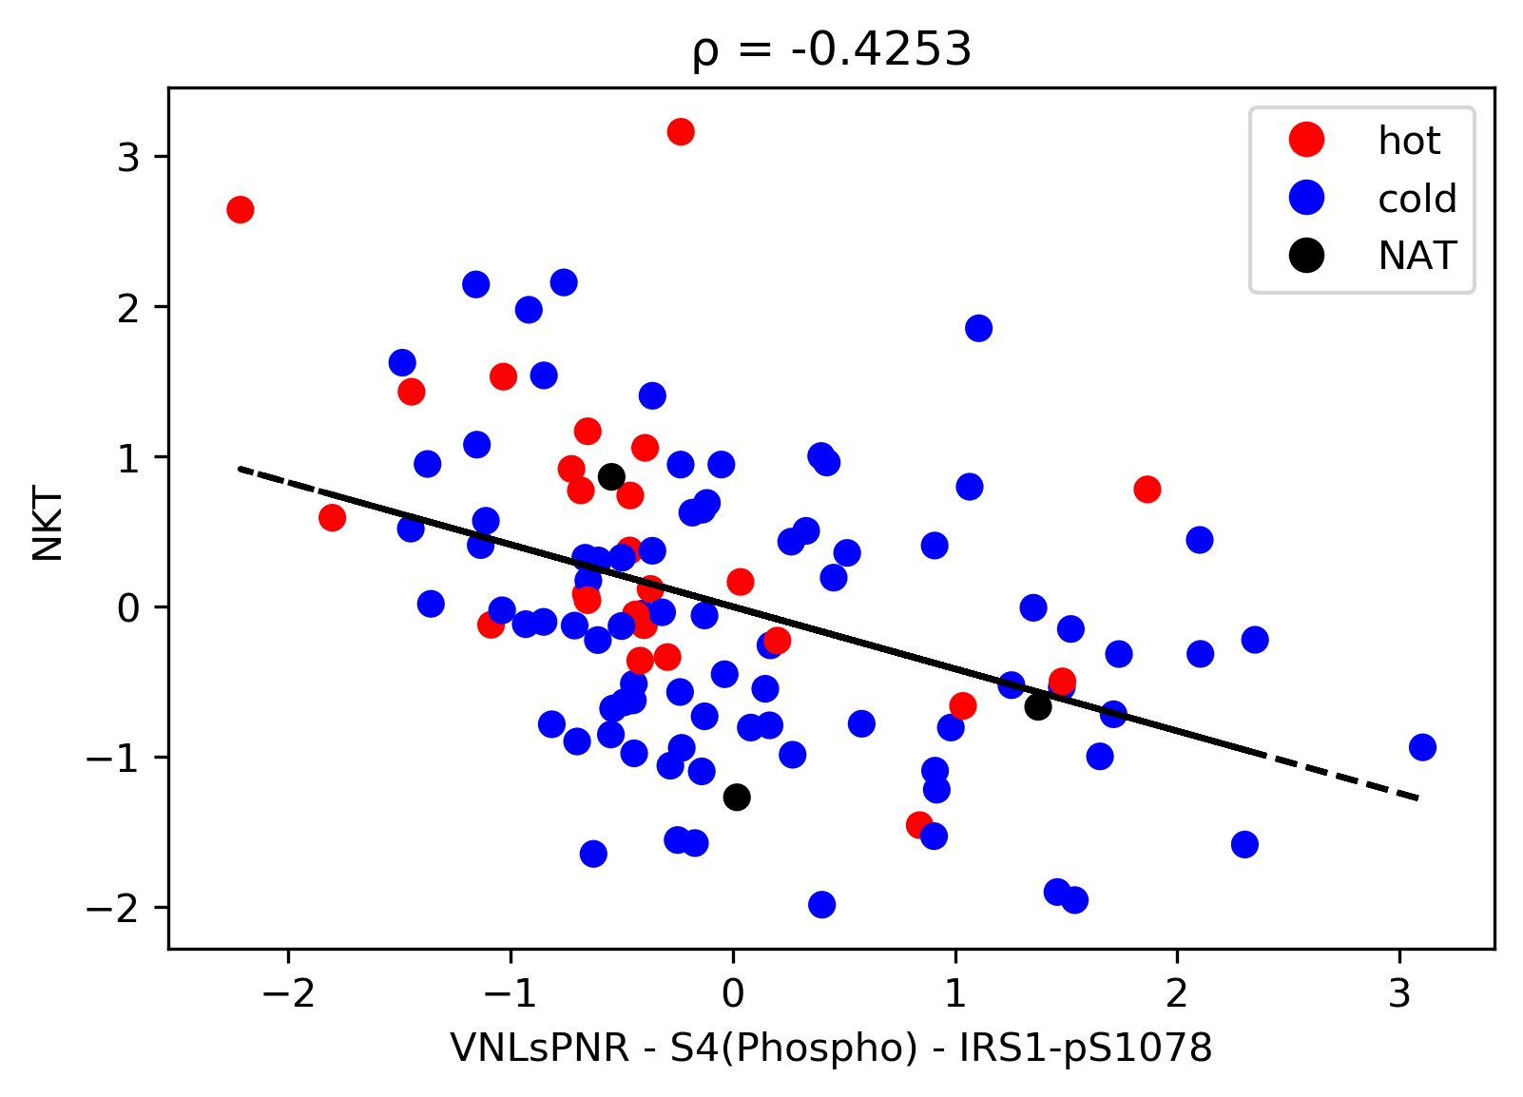
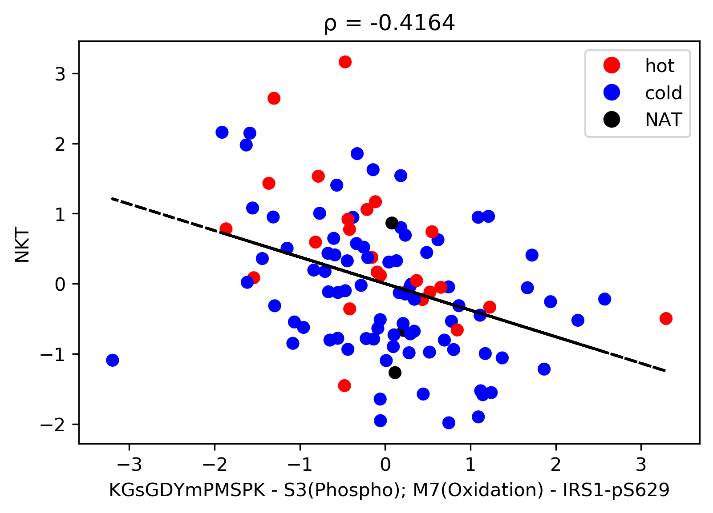
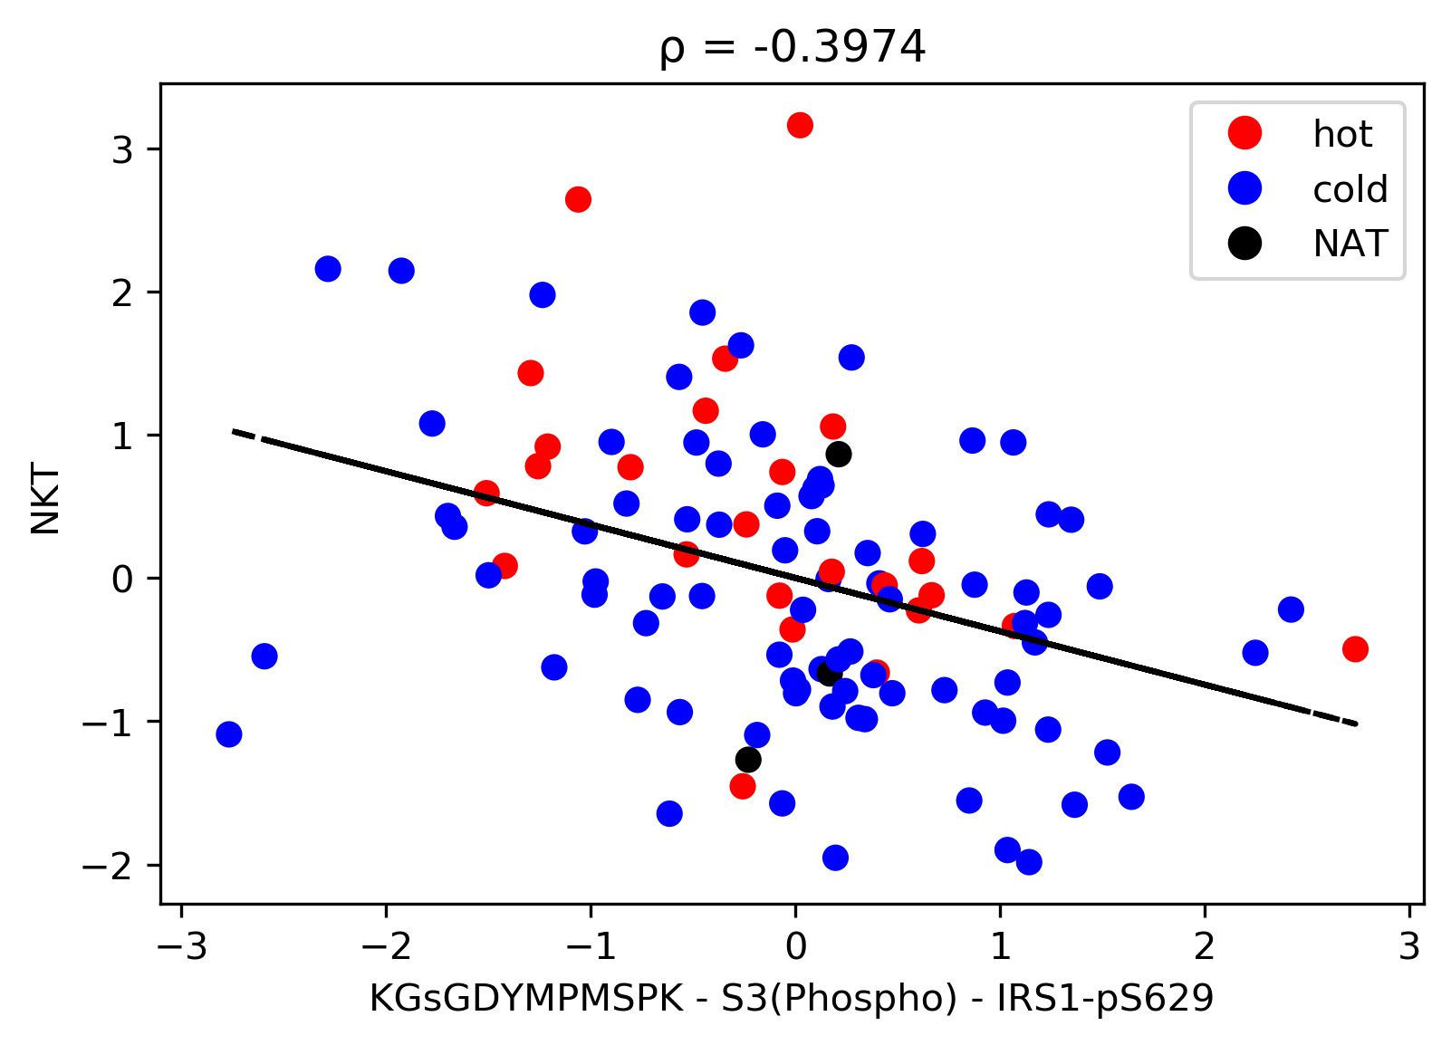
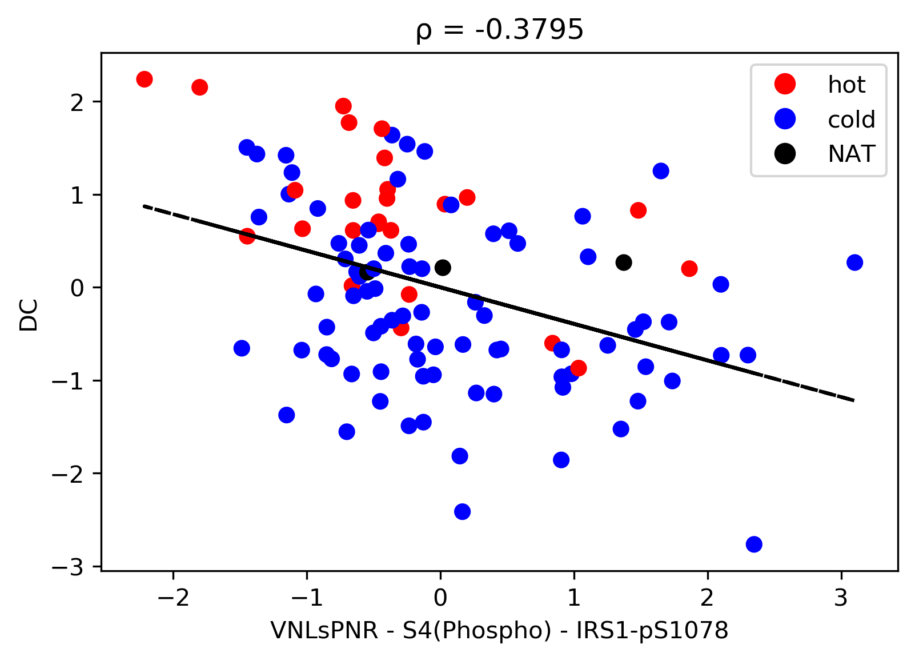
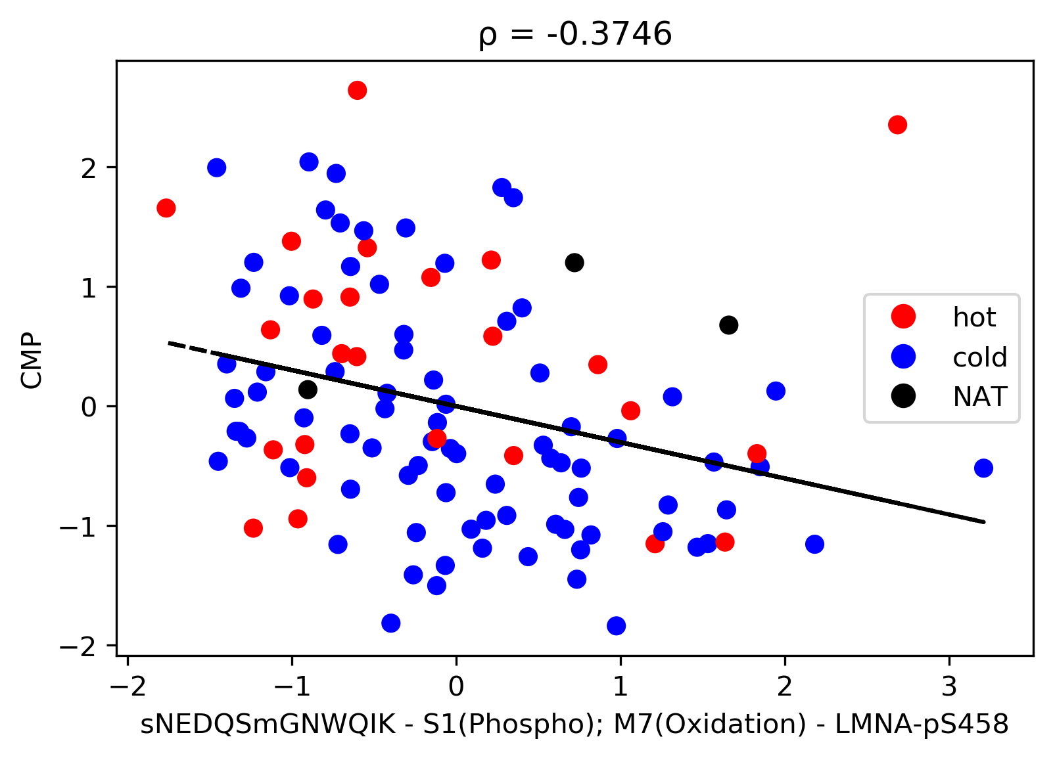
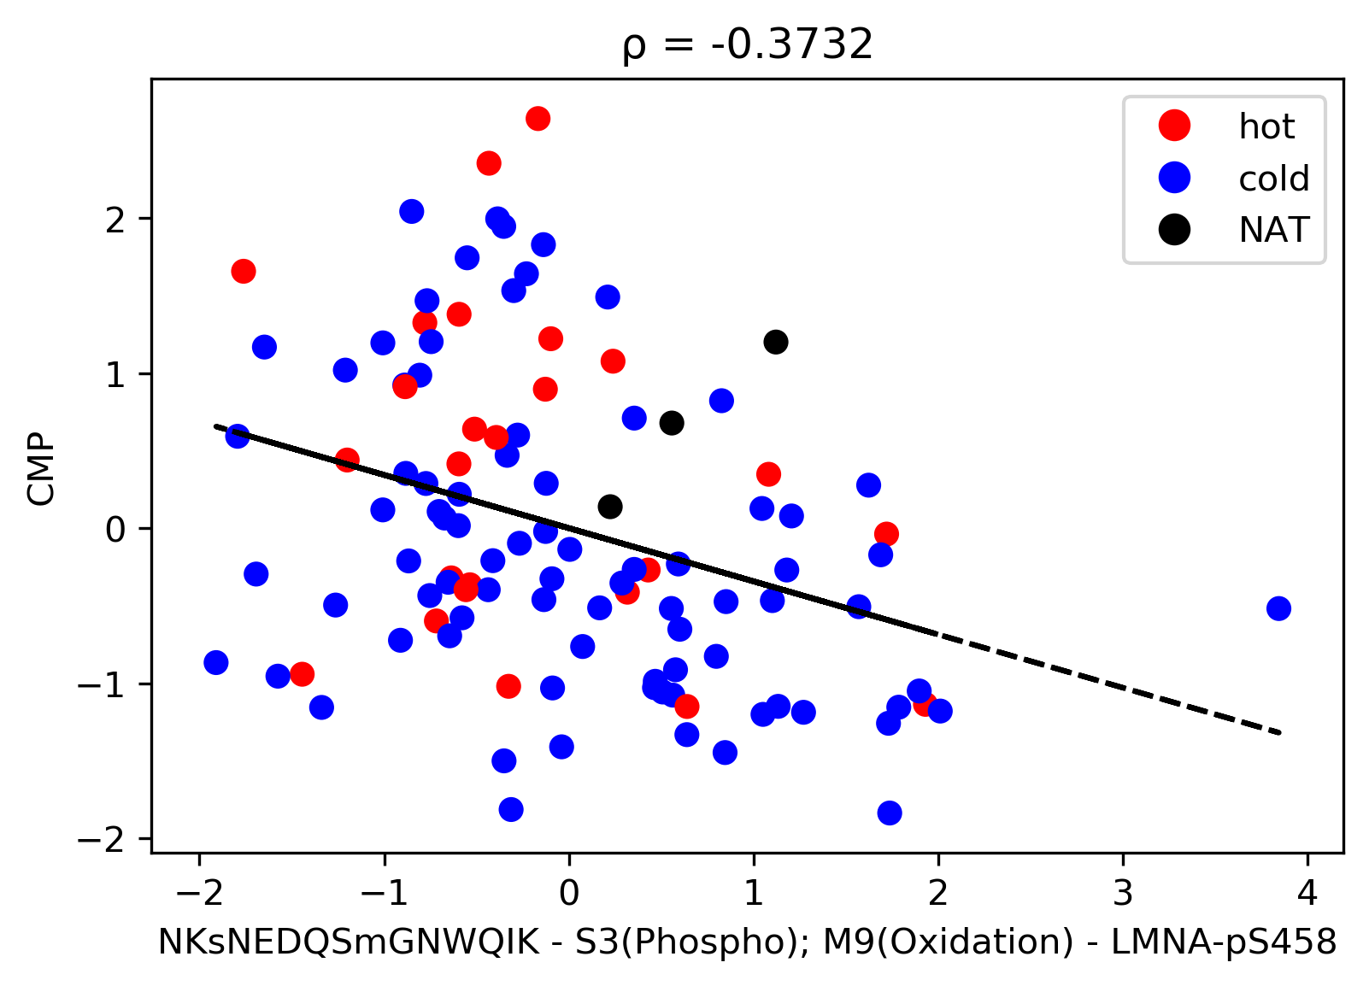
Least Correlated Peptides and Immune Cells
Notes:
If IRS1 absent, more likely to have NKT? If many NKT, less signaling by IRS1?
NKT- regulatory T cells that bridge the innate and adaptive immune system; secrete cytokines → powerful effects on αβ T cell differentiation and functions
IRS1 (insulin receptor substrate 1)- may mediate the control of various cellular processes by insulin; when phosphorylated by the insulin receptor binds specifically to various cellular proteins containing SH2 domains
DC (dendritic cells)- process antigen material and present it on the cell surface to T cells of immune system; messengers between innate and adaptive immune systems.
CMP (common myeloid progenitor)- HSC undergo progressive commitment to generate CMP cells, which differentiate into other blood cells
LMNA (Lamin A/C)- structural proteins; intermediate filaments that provide stability and strength to cells; supporting components of nuclear envelope

Slide 11
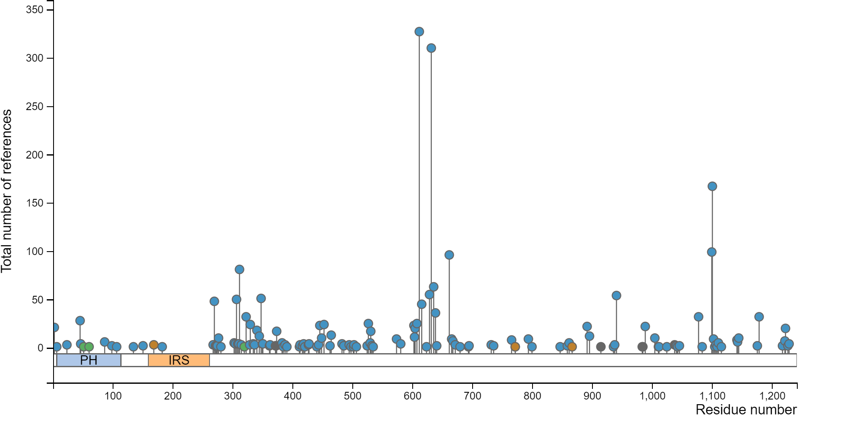
Insulin Receptor Substrate 1 (IRS1)
Notes:
Arrow to sites, not in interesting domain (not many papers published)
1078 and 629

Slide 12

Future Work
Biomarker analysis
Found matches between sample peptides and biomarkers
['NES', 'VIM', 'NRP1', 'SPN', 'RORA', 'S100A9', 'NFKB1', 'STAT1', 'C5AR1', 'CD44', 'GP1BB', 'KIT', 'STAT3', 'RUNX1', 'ALDOC', 'PECAM1', 'PTPRC', 'AQP4', 'PEA15', 'ITGA4', 'FOXO1', 'NDRG2', 'MSR1', 'VPS54']
Predictions based on signatures
Other datasets
Notes:
Screenshot of angela’s spreadsheet
Challenges: why samples separate
Hard to predict each cell type individually → can we find handful of cells with signature? Or can we classify groups of cells (innate, adaptive)?
How do rna-seq predictions work?

